Slide 1
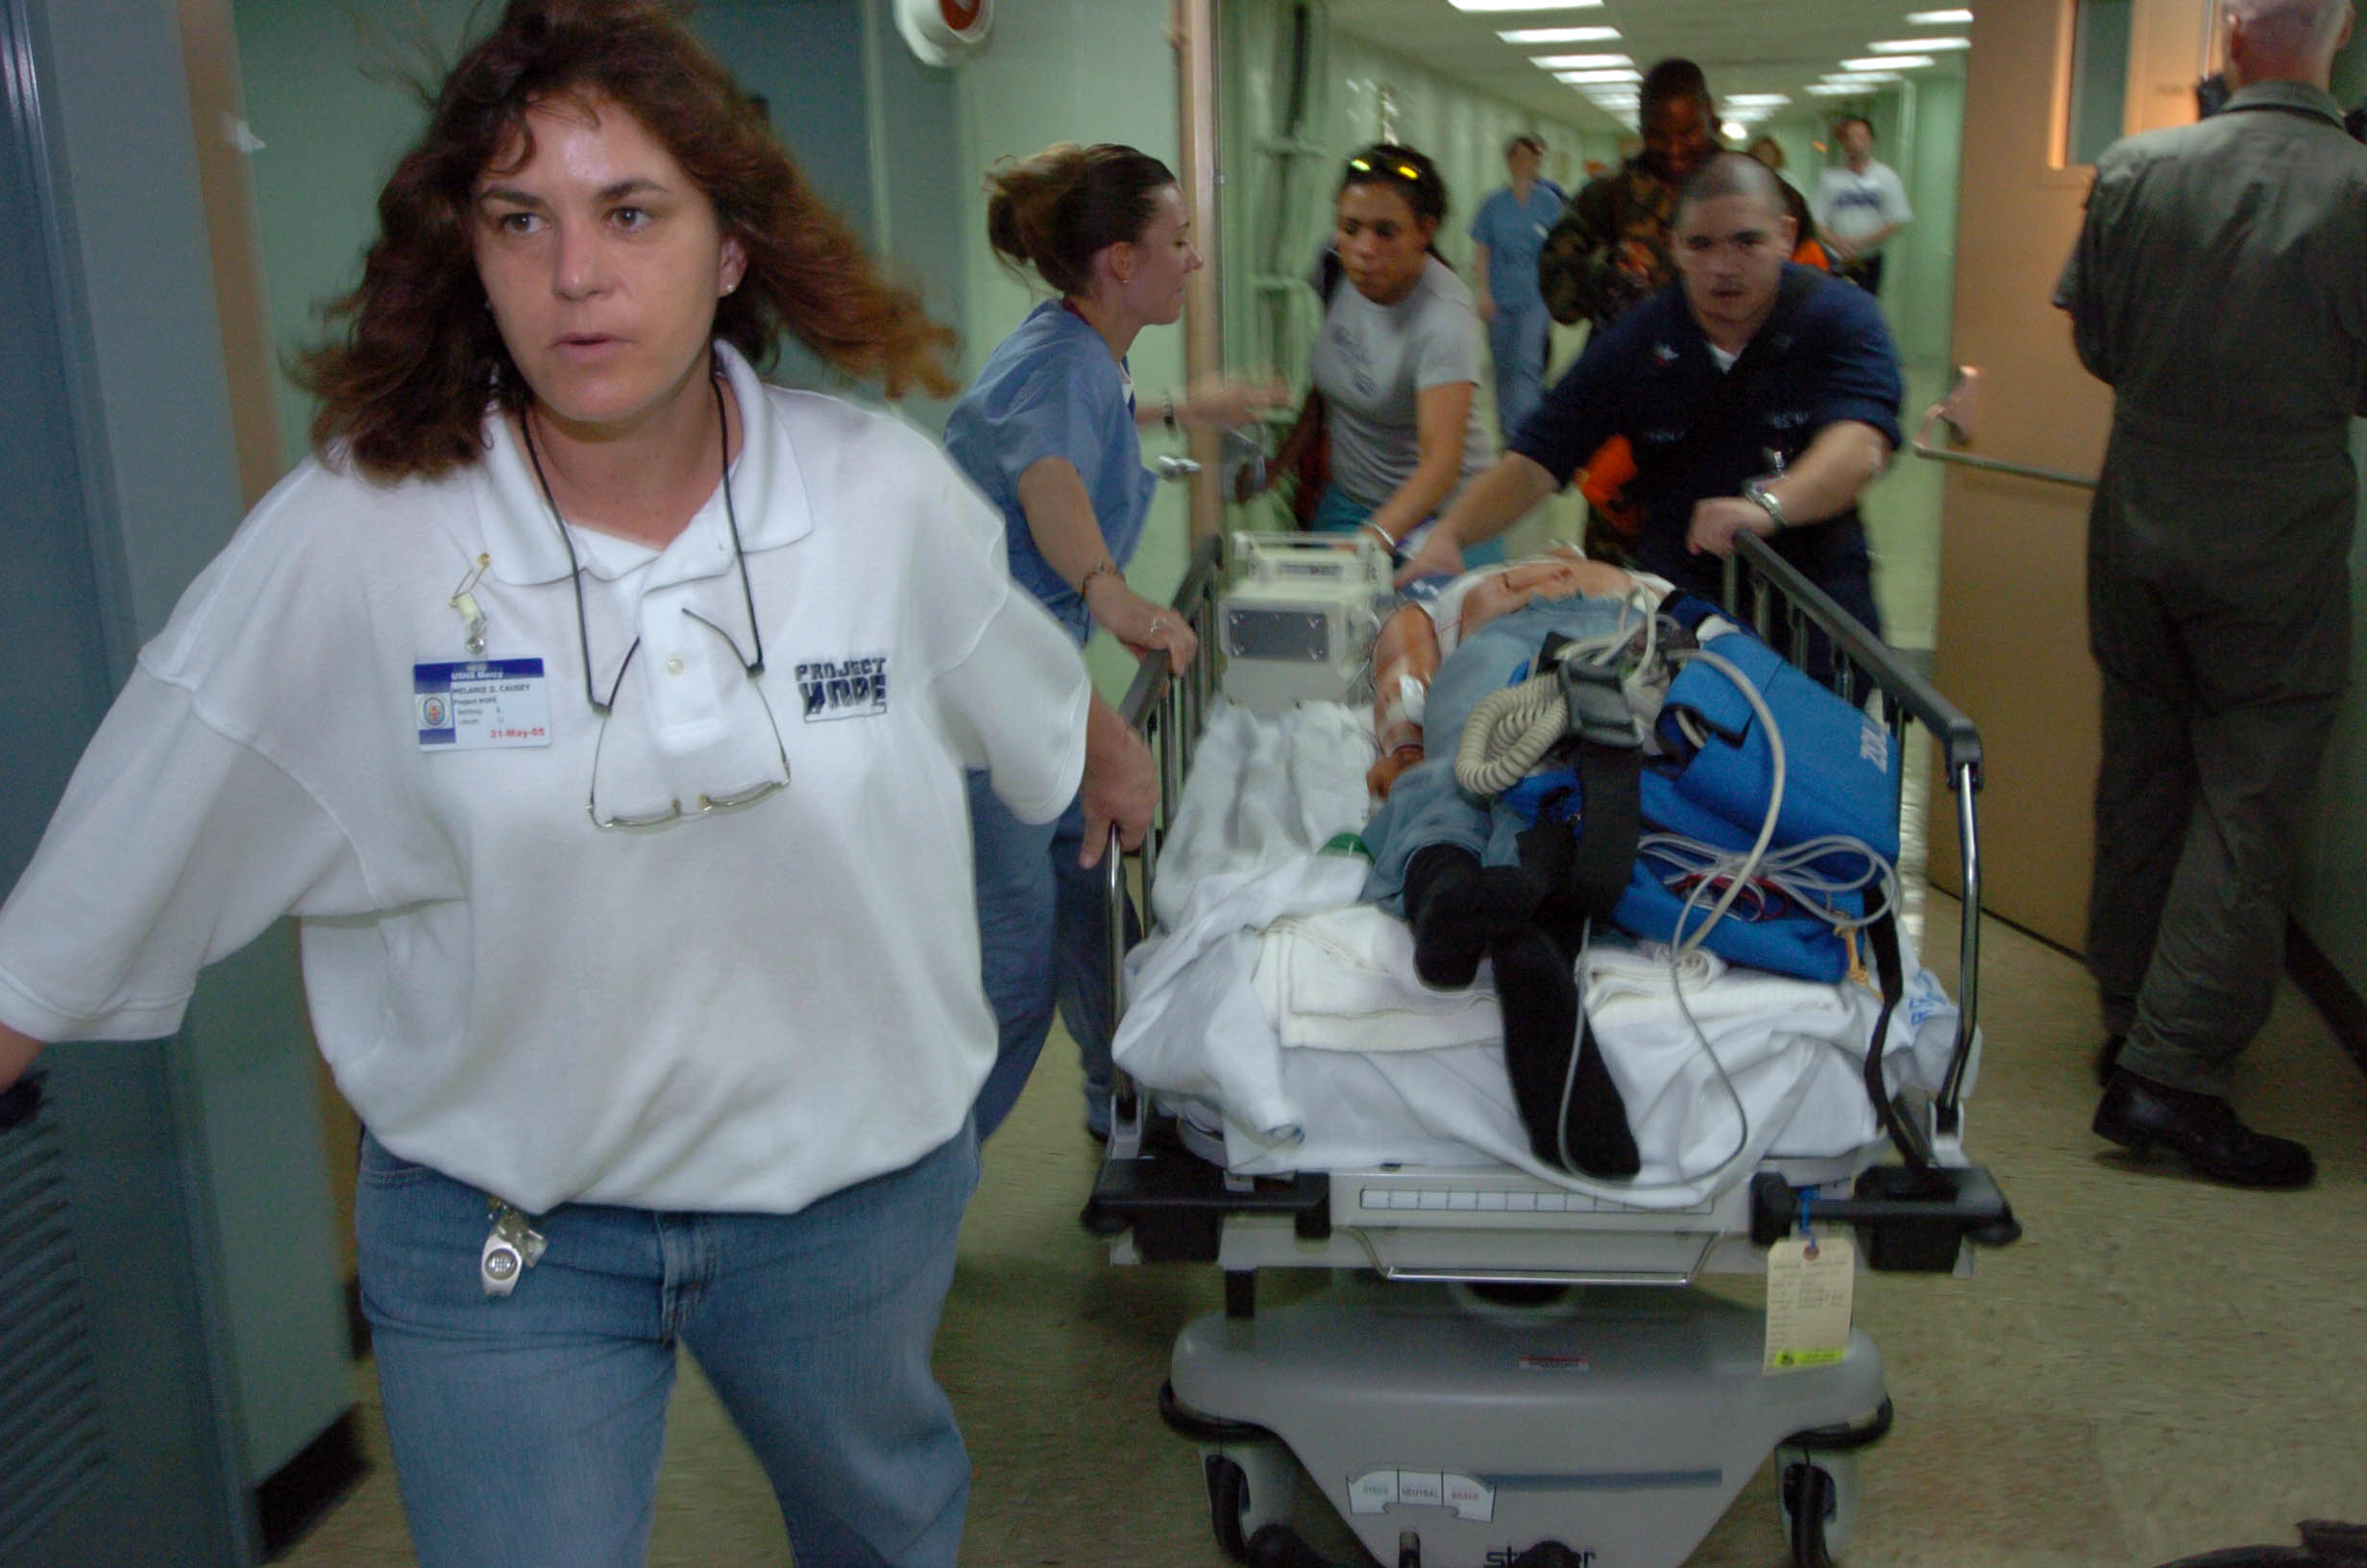

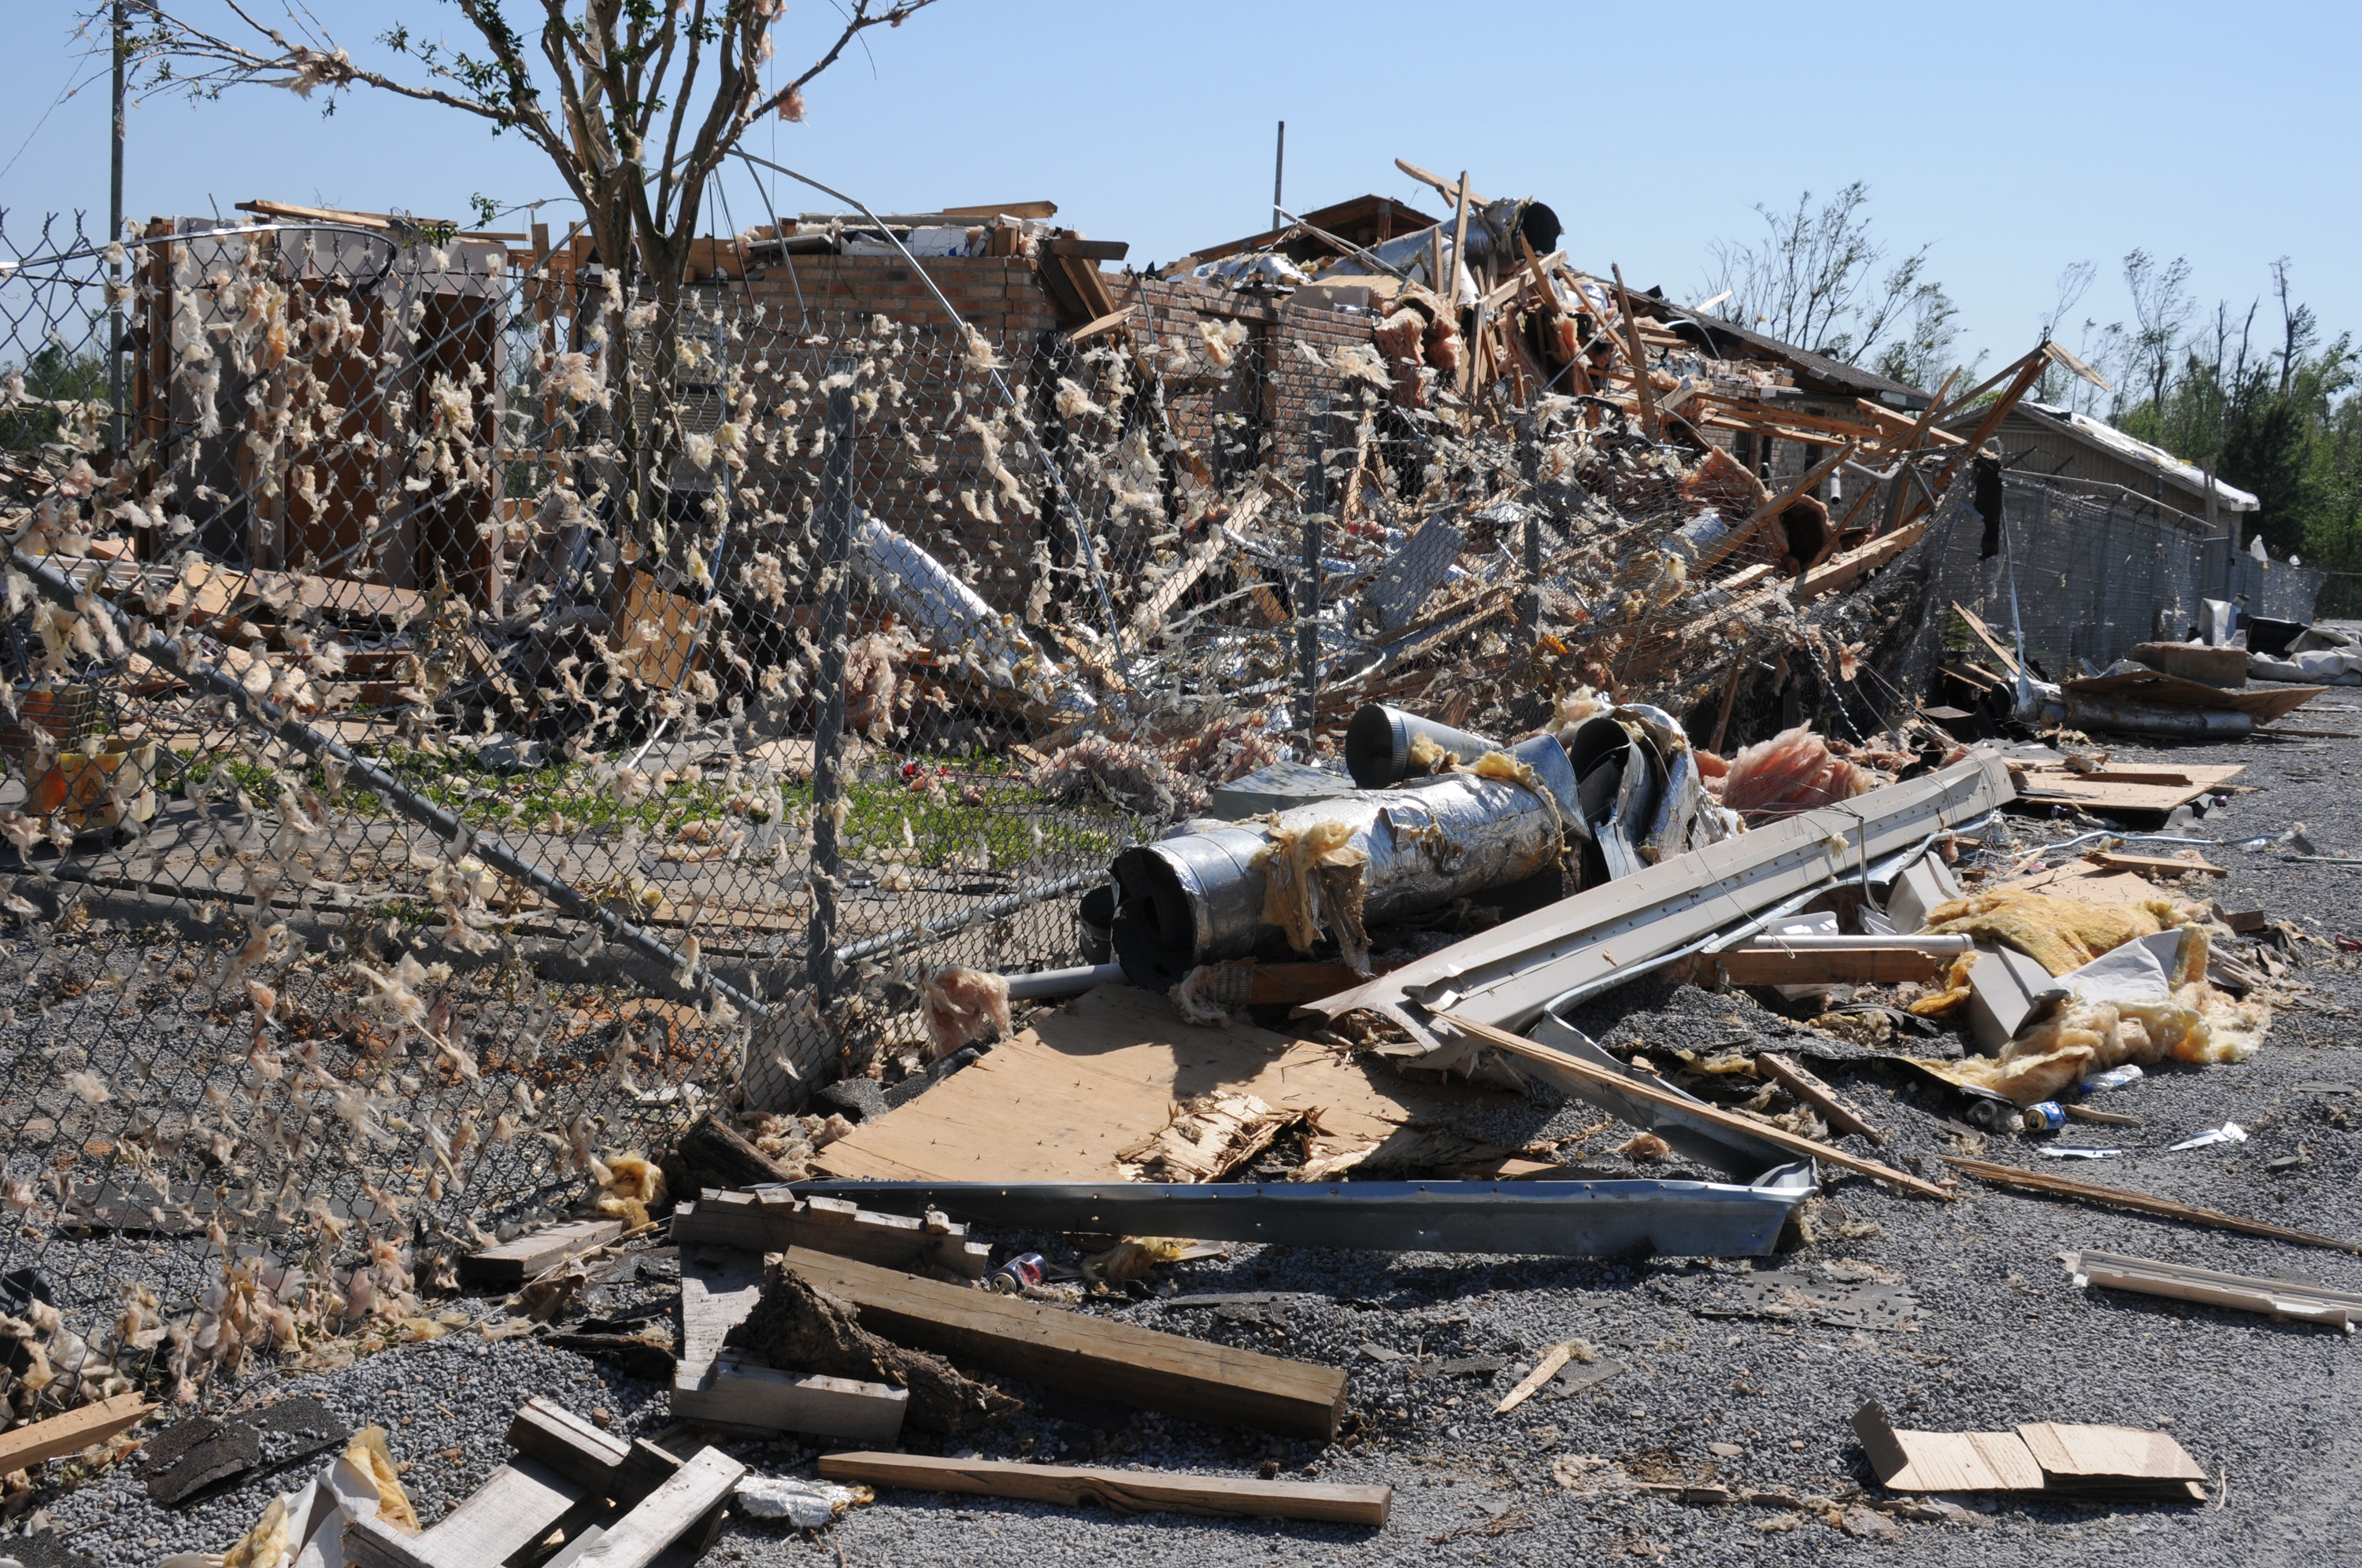
Emergency Response Plan: How Can We Shape The Future Of the IUC
Care
Recovery
Response

Slide 2
Project Overview
Problem Statement:
The annual US health care spend represents 17.9% of the US GDP ($3.65 Trillion).
The budget allocated by FEMA in the event of emergency is estimated at $1Billion.
The health care system is a decentralized cluster.
Response to demand for acute and emergency care remains unsolved in the event of disasters or unplanned events.
Hospitals already function near to max capacity. Hospitalization rose between 15-35%, 72 hrs post any disaster.

Slide 3
ER KPI Metrics – (Average in US)
Emergency Care Cost per Person
ER Room
$5571
Hospital Transfer
$13/Mil (trans. Cost)
Other Charges
(i.e. Ibuprofen $60, Eye drops $238)
$500 - $650
Extract based on survey conducted on 1182 patients

Slide 4
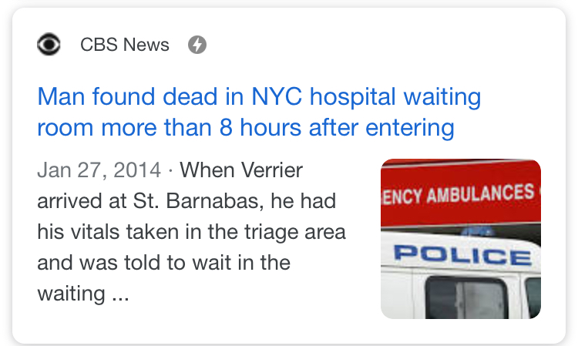
ER KPI Metrics – (Average in US) – Cont.
30-45 min
Waiting Time
160 min
TUSH (Time until sent home)
50-90 min
Broken Bones
90-160 min
Transfer Time

Slide 5
Facts: Katrina Impact
Extracted from Disaster Medical Public Health

Slide 6
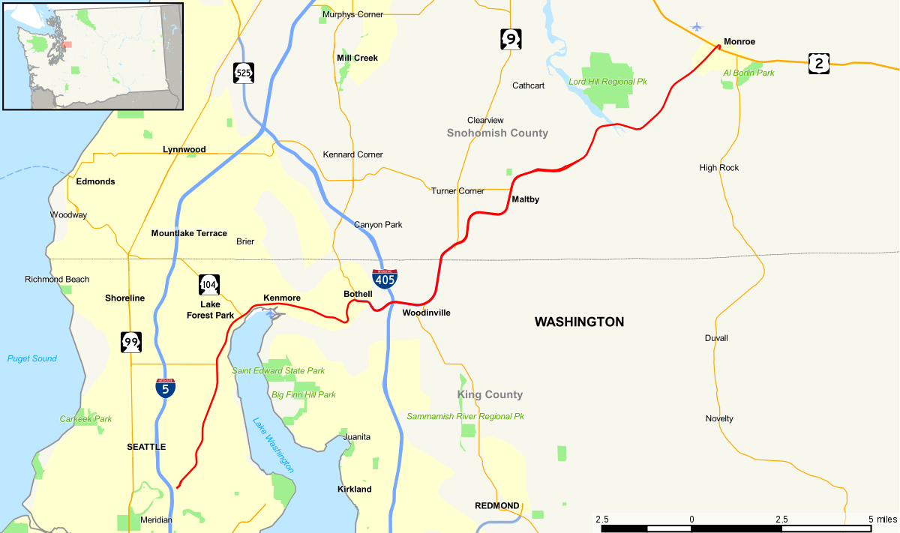




Mitigation Plan – Process Design
Emergency Call
In order to alleviate this crisis, project Lynk is born to provide centralized solution with patient experience in mind.
Start
Shelter Trans. / Medical Care
Out of Scope for this Phase
Shelter Trans.
End
Medical
Collect Patient Information
Perform & Document Evaluation Results
EMT Operator Logs into LYNK and enters Patient data
1
H3
Resource Availability
OR Availability
Blood Type/Supplies
No of Beds
H1
Display Search Criteria (Sort by Distance)
2
Resource Availability
OR Availability
Blood Type/Supplies
No of Beds
H2
3
Resource Availability
OR Availability
Blood Type/Supplies
No of Beds
End

Slide 7
Socio-economical Impact
Improve emergency Care System
Reduce Cost associated to inter-hospital transfers
Increase outpatients charge turnaround
Allocate resources and reduce overheads

Slide 8
Application Demo
Demo video - https://youtu.be/UmfwzZzrV6U

Slide 9
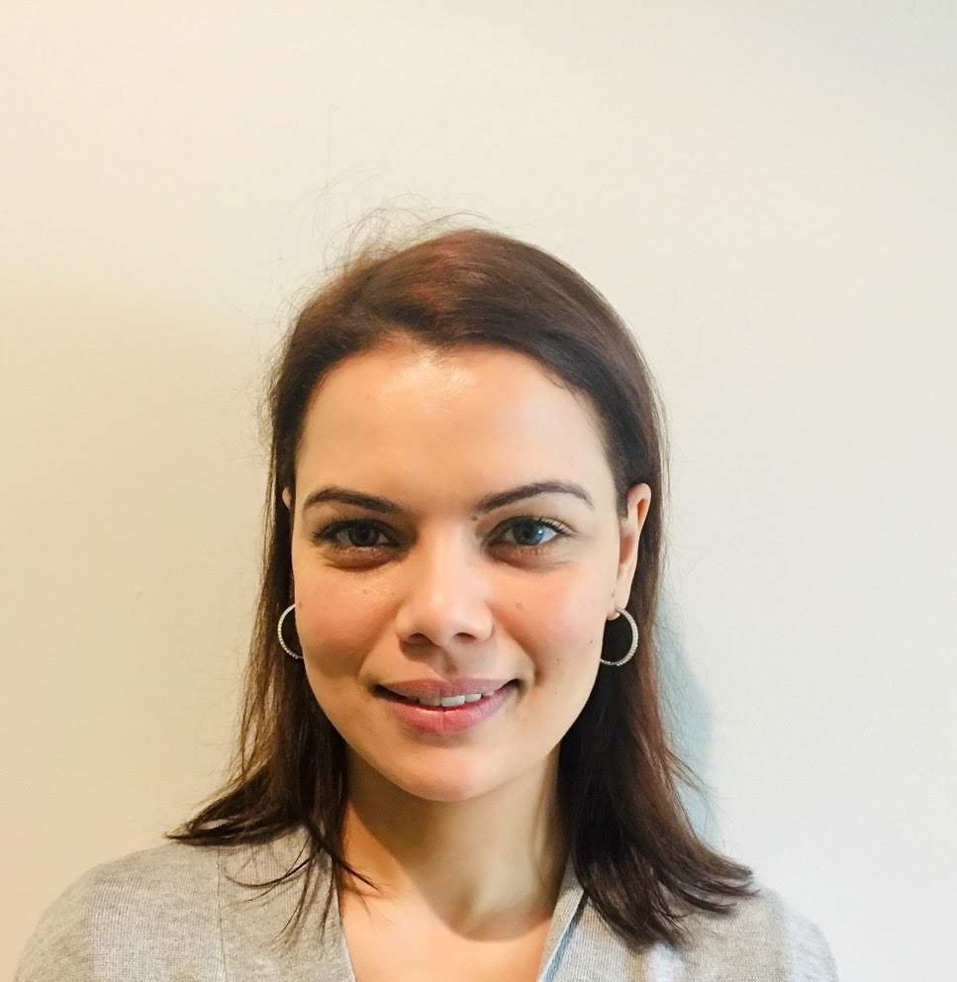
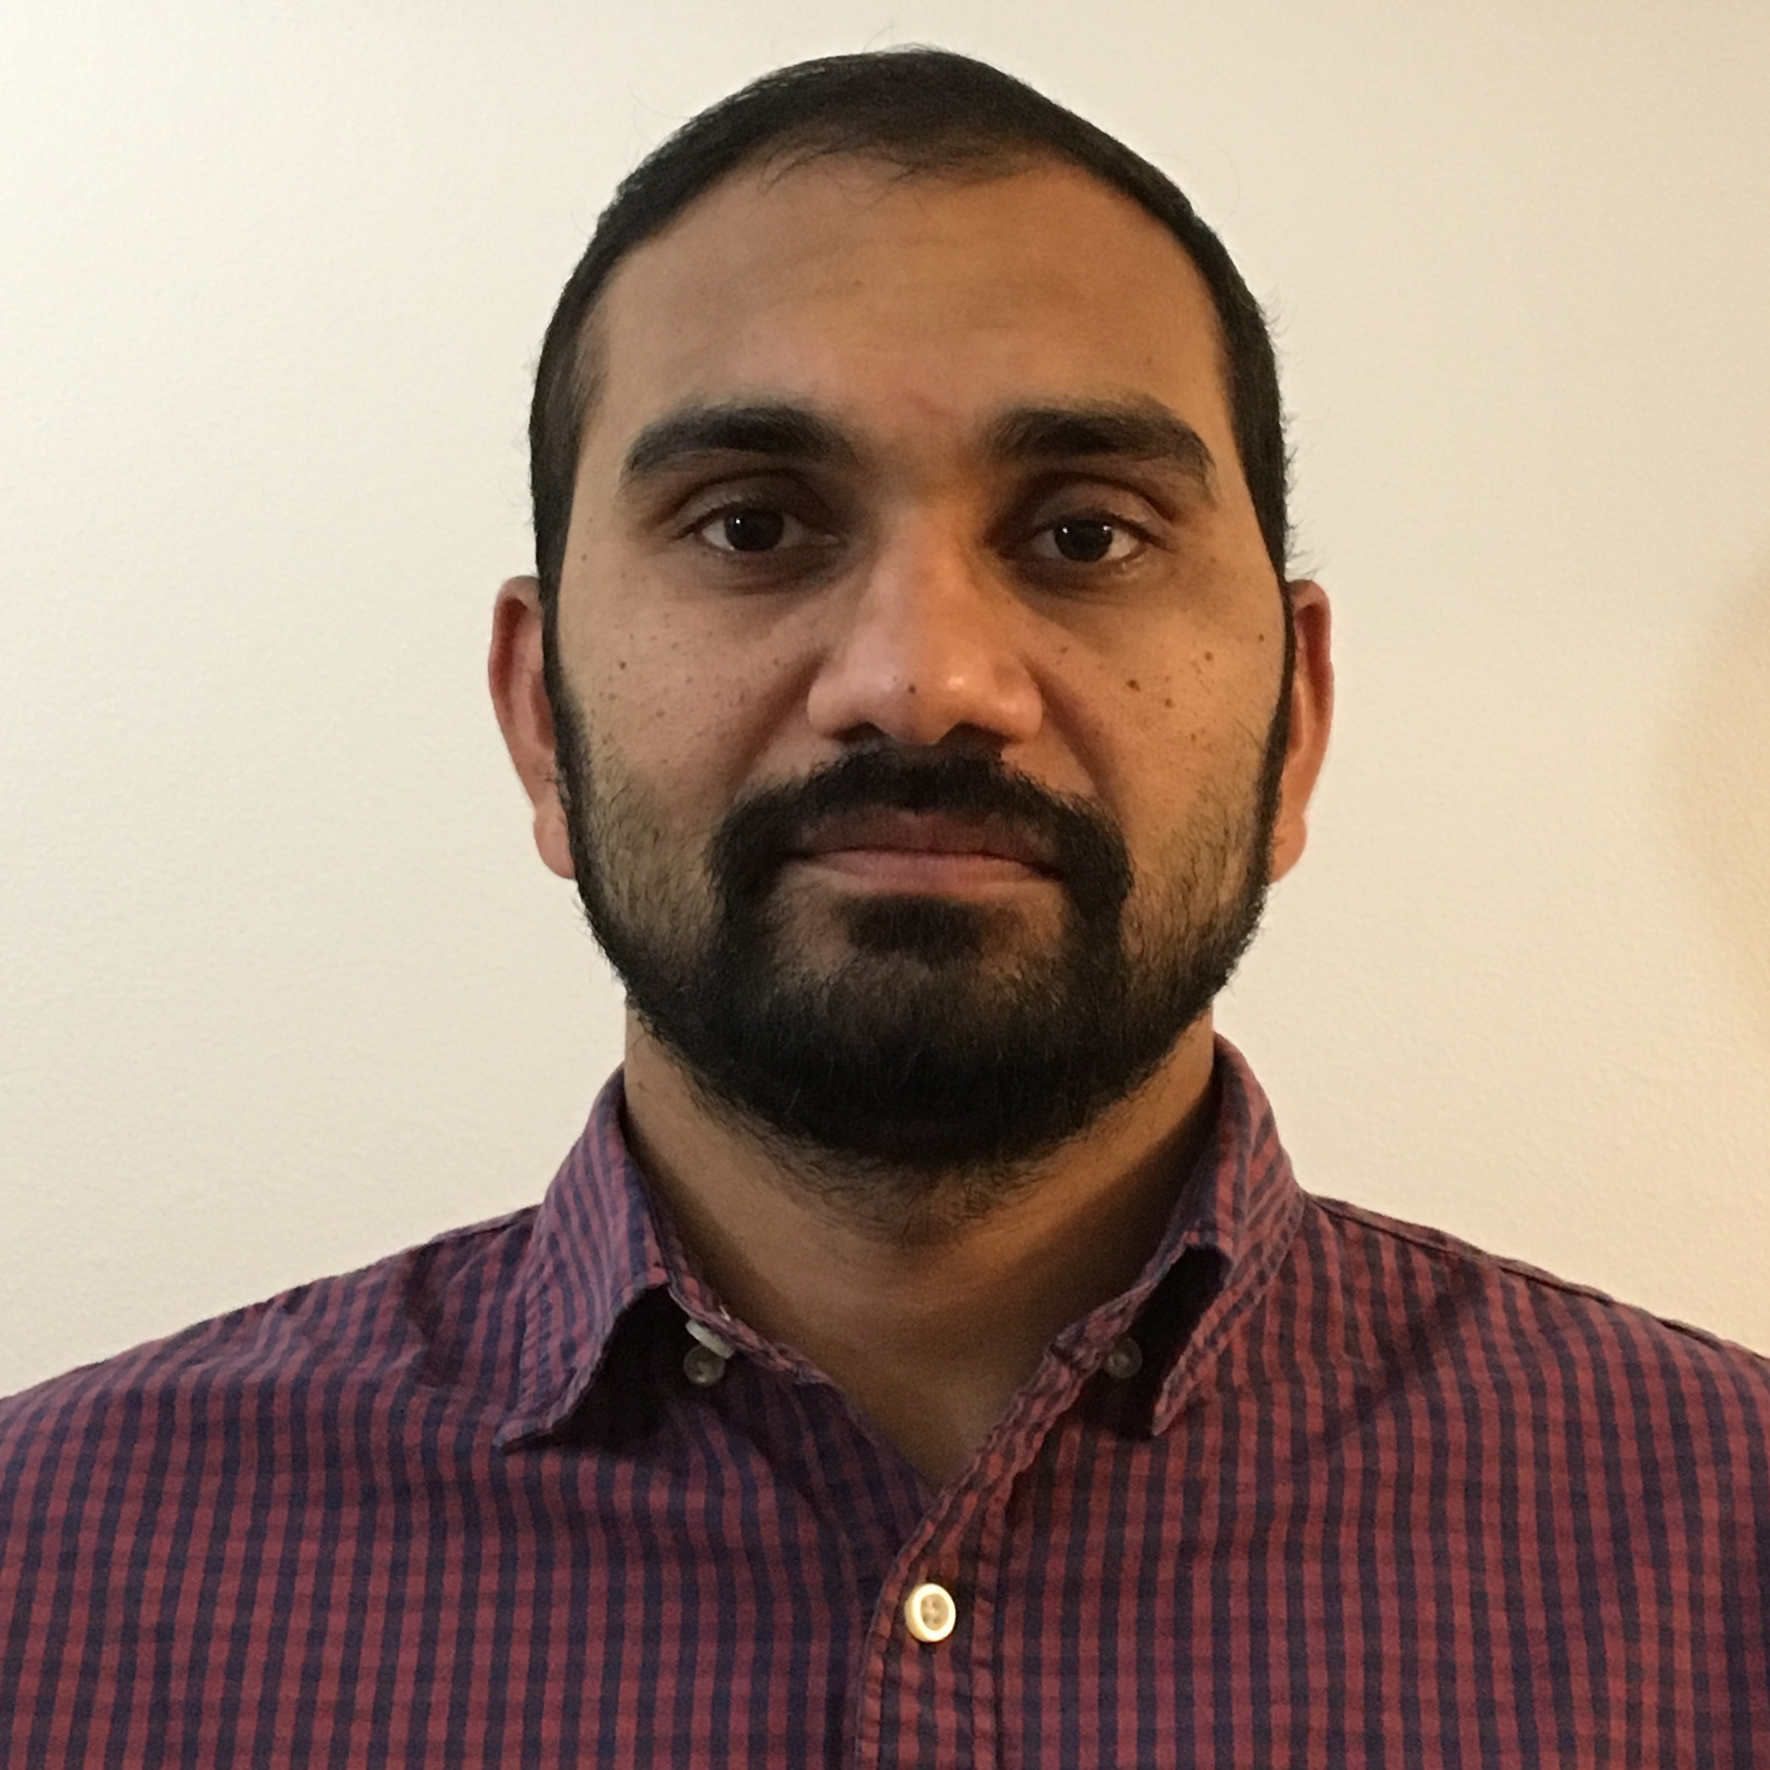
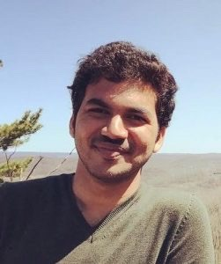
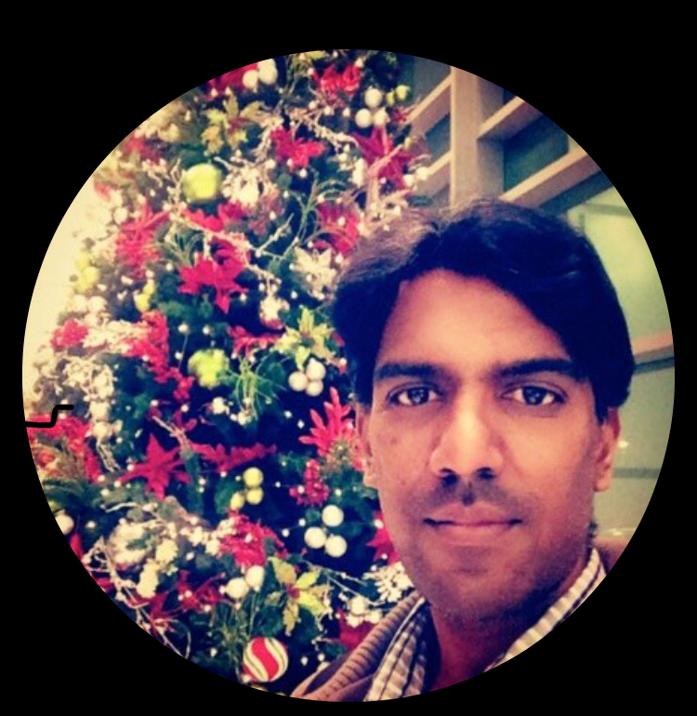
Meet The Team
Meryem Khribech
Lakshmi Kallam
Srujith Poondla
Balachandar Balaraman

